Slide 1
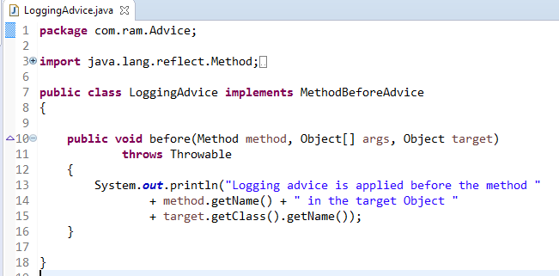
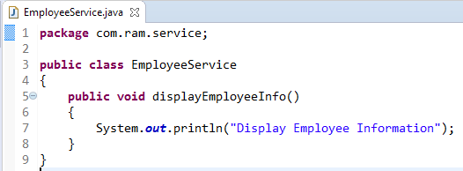
BeforeAdvice Example
Before Advice is executed before the actual method call.
Before Advice
method
1
2

Slide 2
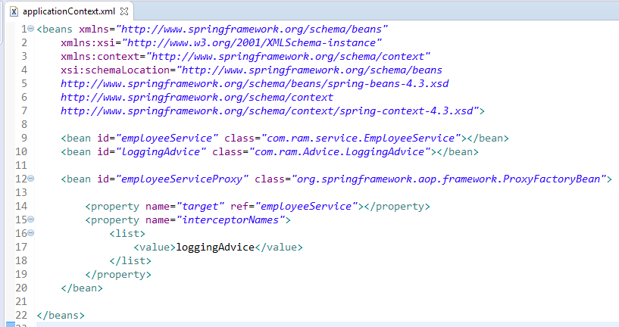
BeforeAdvice Example
In xml file, create 3 beans, one for EmployeeService class, second for LoggingAdvice class and third for ProxyFactoryBean class.
The ProxyFactoryBean class is provided by Spring Famework. It contains 2 properties target and interceptorNames. The instance of EmployeeService class will be considered as target object and the instance of LoggingAdvice class as interceptor.

Slide 3
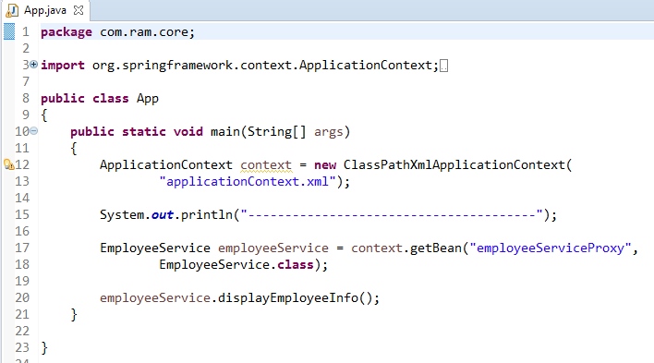
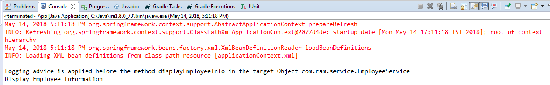
BeforeAdvice Example

